Slide 1
Writing and publishing in the doctorate
Montserrat Castelló, Anna Sala-Bubaré & Mariona Corcelles
FPCEE Blanquerna – URL (Barcelona)

Slide 2
PROGRAM
Writing and publishing in the doctorate
Aims
To learn the characteristics of the genre research article: structure and micro-resources
To develop useful and efficient strategies and resources to write the different sections of a research article
To learn to revise texts and receive feedback from peers
To learn the publication process
To reflect on own characteristics as writers and on their own writing processes

Slide 3
SESSION 1
Writing and publishing in the doctorate
Contents and activities
Think fast!
What is the first word that comes to your mind when you think of research writing?

Slide 4
SESSION 1
Writing and publishing in the doctorate
Contents and activities

Slide 5
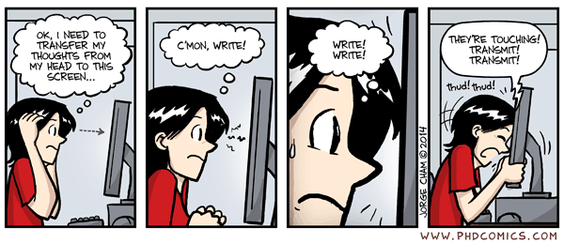
SESSION 1
Writing and publishing in the doctorate
Contents and activities

Slide 6
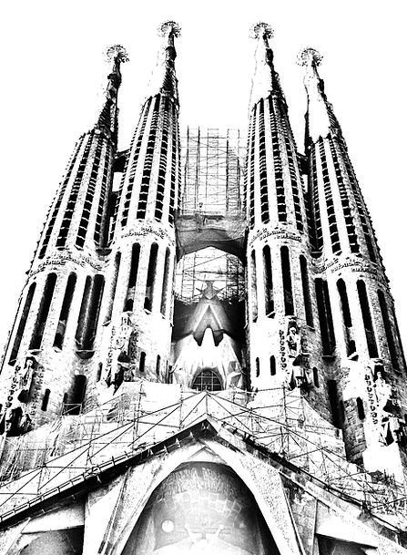
SESSION 1
Writing and publishing in the doctorate
What is academic writing?
CONTEXT
(audience, discipline, community)
CODE and LANGUAGE
(grammar, syntax, vocabulary, orthography)
TOPIC
(content)
GENRE
(report, research paper, thesis…)
ME AS WRITER
(motivations, writing strategies, goals, strengths and weaknesses…)
WRITING PROCESS

Slide 7
SESSION 1
Writing and publishing in the doctorate
What is academic writing?
PLANNING
TEXTUALISATION
REVISION

Slide 8
SESSION 1
Writing and publishing in the doctorate
What is academic writing?
Task CONCEPTUALISATION
WRITER’S
KNOWLEDGE
WRITTEN TEXT(S)

Slide 9
SESSION 1
Writing and publishing in the doctorate
What is academic writing?
Task CONCEPTUALISATION
Planning, composing and revising?
WRITER’S
KNOWLEDGE
WRITTEN TEXT(S)

Slide 10
PLANNING
SESSION 1
Writing and publishing in the doctorate
What is academic writing?
What is the purpose of the text?
What is my purpose?
Why I write this dissertation? My motives/reasons
What I would like to shown/demonstrate/discuss/accomplish?
To whom it is addressed? Who will read it?

Slide 11
WRITING
SESSION 1
Writing and publishing in the doctorate
What is academic writing?
What I have just written is related with what I am going to write? How are those ideas related?
Is the text just written aligned with my purpose?
Am I keeping the focus?

Slide 12
REVISING
SESSION 1
Writing and publishing in the doctorate
What is academic writing?
Are the text purposes/objectives explained?
Does the text reach them?
Is the structure of the text clear and appropriate?
Are there problems, mistakes in paragraphs or sentences?
Are there grammar or format problems?

Slide 13
Planning also happens when
READING TO WRITING
TALKING TO WRITING
TALKING ABOUT WRITING

Slide 14
Learning about our own writing process
“Rastrear” the process
Production “rate”
More knowledge = less anxiety

Slide 15
Reading our text as a “reader”
Read it aloud
Let it “reposar”
Make questions to the author
“Look” only at some aspects
(structure, content, voice, formal aspects)

Slide 16
SESSION 1
Learning to write in the doctorate
Writing conceptions
What writing conceptions can hinder or boost my writing?

Slide 17
SESSION 1
Learning to write in the doctorate
Writing conceptions
Blocks: the inability to produce text (Rose, 1980)
Procrastination: the action of delaying or postponing important tasks (Onwuegbuzie, 2000)
Perfectionism: the constant search of a perfect product and the establishment of unrealistic standards, and thus the endless revision and inability to finish texts (Boice, 1993; Kearns, Forbes, Gardiner, & Marshall, 2008)
Productivity: seeing oneself as being a productive, effective and active writer (Pyhältö, Nummenmaa, Soini, Stubb & Lonka, 2012).
Knowledge creation: seeing writing as a knowledge-transforming tool and seeing oneself as a productive writer (Bereiter & Scardamalia, 1987).
Innate ability: seeing writing as an abililty that cannot be improved, as an innate gift (Lonka et al., 2014).
* Sala-Bubaré, A., Peltonen, J. A., Pyhältö, K., & Castelló, M. (2018). Doctoral candidates’ research writing perceptions: A cross-national study. International Journal of Doctoral Studies, 13, 327-345.

Slide 18
SESSION 1
Learning to write in the doctorate
Writing conceptions
 | Blocks | Procrastination | Perfectionism | Productivity | Innate ability
* Sala-Bubaré, A., Peltonen, J. A., Pyhältö, K., & Castelló, M. (2018). Doctoral candidates’ research writing perceptions: A cross-national study. International Journal of Doctoral Studies, 13, 327-345.

Slide 19
SESSION 1
Learning to write in the doctorate
Writing conceptions
 | Blocks and procrastination | Perfectionism | Productivity
Struggler Writers
Reduced productivity writers
Productive writers
No differences among profiles regarding knowledge production (high) and innate ability (low).
Blocks and procrastination were revealed as one single factor.
* Sala-Bubaré, A., Peltonen, J. A., Pyhältö, K., & Castelló, M. (2018). Doctoral candidates’ research writing perceptions: A cross-national study. International Journal of Doctoral Studies, 13, 327-345.

Slide 20
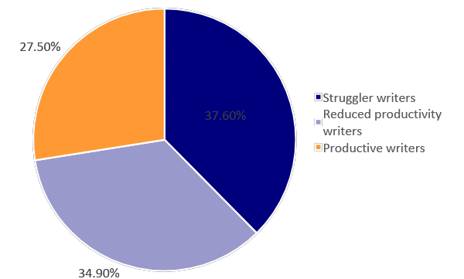
SESSION 1
Learning to write in the doctorate
Writing conceptions
37.60%
* Sala-Bubaré, A., Peltonen, J. A., Pyhältö, K., & Castelló, M. (2018). Doctoral candidates’ research writing perceptions: A cross-national study. International Journal of Doctoral Studies, 13, 327-345.

Slide 21
SESSION 1
Learning to write in the doctorate
Writing conceptions
 | Struggler writers | Reduced productivity | Productive writers
Age |  | - | +
Gender | ♀ |  | ♂
Drop-out risk | + |  | -
N. articles publ. |  | - | +
Social support | - |  | +
Phase PhD | = | = | =
Time modality | = | = | =
Country **Spain, Finland and UK | = | = | =
Thesis language | = | = | =
Research group | = | = | =
* Sala-Bubaré, A., Peltonen, J. A., Pyhältö, K., & Castelló, M. (2018). Doctoral candidates’ research writing perceptions: A cross-national study. International Journal of Doctoral Studies, 13, 327-345.

Slide 22
SESSION 1
Learning to write in the doctorate
Writing conceptions
The Writing Scale - Instructions
Go to the link: http://goo.gl/xUDD5c
Download the Excel file
Respond to the writing scale (‘Questionnaire’ tab)
Look at your results (‘PhD students’ or ‘Postdocs’ tab)
Compare your results with those of your community
Share them with your workshop colleagues

Slide 23
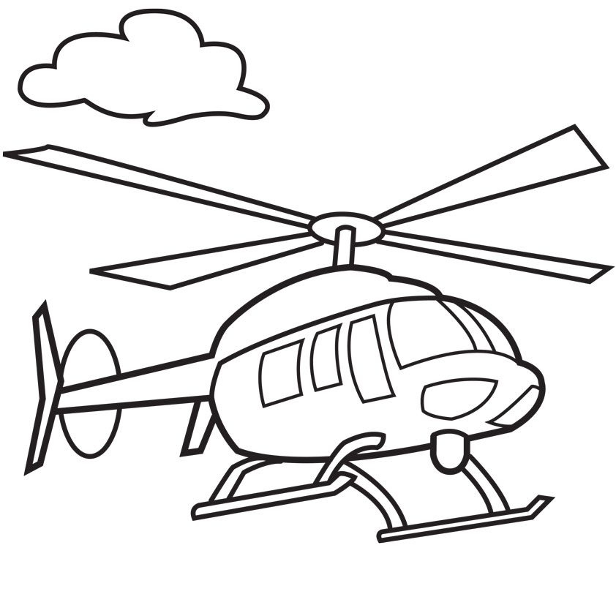
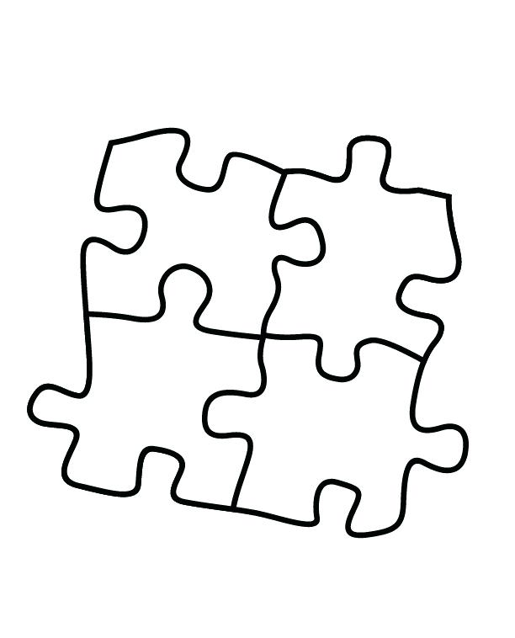
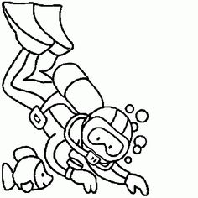
What is my writer profile? How can I better understand my conceptions / difficulties?

Slide 24
Remember the process LP!:
My writing process…
1. When I have to write, do I do it as soon as possible or do I usually postpone its completion until the last moment?
2. When I finish a text, am I always rereading and modifying aspects that I think can be improved, or I do not read it again?
3. Do I always plan the text before writing or, on the contrary, do I start writing without thinking too much and then I modify what is necessary?
4. As I write, do I often stop to reread and modify what I am writing?
5. When I have to write a text, I feel nervous and anxious if ...
6. If I had to use a metaphor or a goal to define my way of writing academic texts I would say that I am ...

Slide 25
Remember the process LP!:
Writer profiles
Profiles related to the shape of the writing process (Castelló, 2007):
Diver
Helicopter
Jigsaw
Chaotic
Castelló, M. (Coord.); Iñesta, A., Miras, M., Solé, I., Teberosky, A., Zanotto, M. (2007). Escribir y
comunicarse en contextos científicos y académicos. Conocimientos y estrategias. Barcelona: Graó

Slide 26
Remember the process LP!:
Diver
Characteristics
Need to write immediately Intensive writing → Ease of filling pages
Often little attention to structure. High production in initial stages
Problems or difficulties
Organizing the text → need to impose a structureon the produced text
→ involves simultaneous review, renounce part of the produced text
Obtain the big picture → need to exit the "immersion", representation of the full text

Slide 27
Remember the process LP!:
Diver
Risks
Risk of abandonment due to the difficulty of structuring a text already produced. Risk of starting over from scratch due to the ease of producing in early stages.
Strategies
Conceive the first version as a more or less textualized brainstorm, which helps us to think about the text, to advance gradually towards concretion of the ideas to be dealt with in the text. Impose moments of planning and review, before and especially during writing.

Slide 28
El escritor helicóptero
Helicopter
Characteristics
Opposite Profile Extensive writing → need to dominate the big picture before starting to write.
Definition of structure, planning, before writing. Little attention to the details of each of the sections.
Problems or difficulties
Starting to write without a clear idea of the content and structure of the text. Achieve a global and at the same time detailed image of a complex text. Anxiety in front of the blank page → inability or difficulty to start writing → lack of production → increased anxiety.

Slide 29
El escritor helicóptero
Helicopter
Risks
Risk of abandonment due to wasting time and anxiety. Risk of continuing to plan and read without ever starting to write.
Strategies
Lower anxiety Become aware that it is not possible to achieve such detailed planning before starting to write a complex text.
See the text to be produced “only” as an initial draft. Understand writing (production) as an instrument for (re-)planning.

Slide 30
El escritor puzzle
Jigsaw
Characteristics
"Journalistic" profile 'Copy and paste’ writing → fit pieces of text until you get a final figure with meaning
Different files with portions or pieces of information to complete a new text (texts written by oneself or others).
Problems or difficulties
Achieve the necessary coherence and cohesion. Revision of the text to adapt each paragraph or each new information with the objectives of the new text.
Identification and description of the aspects to be extended.

Slide 31
El escritor puzzle
Jigsaw
Risks
Produce uncohesive or unstructured texts. Abandonment due to difficulties in the revision/adaptation of the text.
Strategies
Define personal and explicit objectives for the new text. Clearly define the structure of the text in order to decide which 'pieces' are suitable for our text and identify which parts will need more information and which ones we will have to write. Plan revision with specific objectives to adapt the text and ensure its cohesion and coherence.

Slide 32
El escritor caótico
Chaotic
Characteristics
Absence of regularities in the way of addressing the process of written composition. Quite frequent profile. The different ways of proceeding depend, to a large extent, on the "inspiration" of the moment.
Problems or difficulties
Define strategies and objectives due to the lack of their own profile. Act strategically according to the needs of each text, every moment of the composition process.
* In addition to those already discussed according to the profile
adopted in every moment..

Slide 33
El escritor caótico
Chaotic
Risks
Procrastinate or postpone writing for lack of inspiration. Increased anxiety in the face of lack of production.
Strategies
Record when and in which situations the same type of problems appear to identify regularities and possible causes of inspiration and adoption of each profile/style. Write on a regular/regular basis. Identify problems, concerns and difficulties in relation to writing.

Slide 34
Remember the process LP!:
My Profile...
Which profile do you identify with the most? Is ir the same for academic texts (eg. Research plan) than for other types of texts? Does your profile match the results of the writing scale?

Slide 35
SESSION 1
Learning to write in the doctorate
Strategies
Effective writing strategies:
Read to write:
Analyse the journal in which you want to publish
Analyse the structure, language, voice and style
Read about research writing (blogs, articles…)
Share and talk about writing:
Find a peer to exchange texts
Start a writing group
Writing workshops
Read your text aloud
Revise your text with a different purpose at a time (structure, voice, grammar…)

Slide 36
SESSION 1
Learning to write in the doctorate
Resources
How can I be a more effective writer?
More Writing Resources...

Slide 37
SESSION 1
Learning to write in the doctorate
Resources
Training materials
The Journey Plot: https://www.researcher-identity.com/single-post/2018/04/16/Journey-Plot-Guide-to-use-it-in-research-education
Activities and guides to reflect about our research trajectory
The Network Plot: https://www.researcher-identity.com/single-post/2018/04/16/Network-Plot-Guide-to-use-it-in-research-education
Activities and guides to reflect about our research network
Conducting a systematic review: https://www.researcher-identity.com/single-post/2018/04/16/Conducting-a-Systematic-Review-Process-and-Tips
Guide and tips to conduct a systematic literature review
Critical incidents in the research trajectory: https://www.researcher-identity.com/blog-1/category/Videos
Videos to reflect about prototypical critical incidents in the doctorate.
www.researcher-identity.com

Slide 38
SESSION 1
Learning to write in the doctorate
Resources
ORGANIZATION AND STRUCTURE, AUTHORIAL VOICE AND INTERTEXTUALITY
https://www.researcher-identity.com/single-post/2018/05/07/Writing-academic-texts-organization-and-structure-authorial-voice-and-intertextuality
ACADEMIC PHRASEBANK
http://www.phrasebank.manchester.ac.uk/introducing-work/
PAPER REJECTION CRITICAL INCIDENT REFLECTION
https://www.researcher-identity.com/single-post/2017/05/18/Video-paper-rejection
www.researcher-identity.com

Slide 39
SESSION 1
Learning to write in the doctorate
Resources
Scientific journals about research and writing
International Journal of Doctoral Studies
https://www.informingscience.org/Journals/IJDS/Overview
Journal of Writing Research:
http://www.jowr.org
Studies in Continuing Education:
https://www.tandfonline.com/loi/csce20
Higher Education Research and Development:
https://www.tandfonline.com/loi/cher20
Blogs and websites:
Doctoral Writing Special Interest Group
https://doctoralwriting.wordpress.com/2018/02/05/a-diy-kit-for-establishing-a-research-writing-group/
The Thesis Whisperer
https://thesiswhisperer.com/
Writing for Research (LSE London)
https://blogs.lse.ac.uk/writingforresearch/

Slide 40
Researcher Identity Development
Strengthening Science in Society Strategies
www.researcher-identity.com
Thank you for your participation!

Slide 41
Notes:
Calza al final este logo?

